Slide 1

Combining TLS with Attestation
Yaron Sheffer, VP of Technology, Intuit
Confidential Computing TLV, Sep. 2024

Slide 2
Motivation
A simple TLS connection to/from a Confidential workload does not benefit from the platform’s guarantees
We introduce Attestation into the connection: strong guarantees regarding the security state of a device
Especially important for initial application setup
Custom solutions exist, we are working on a standard
draft-fossati-tls-attestation-07

Slide 3
Visually…
TLS (Transport Layer Security, formerly SSL)
Authentication
Secure Channel
Platform Attestation

Slide 4

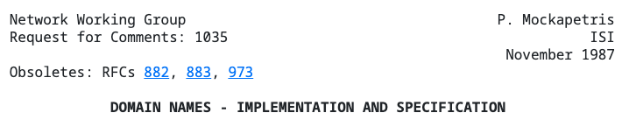
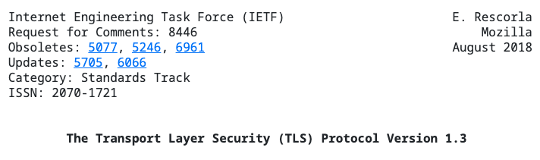
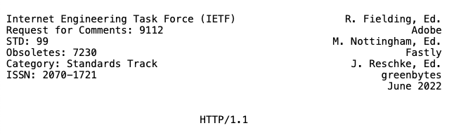
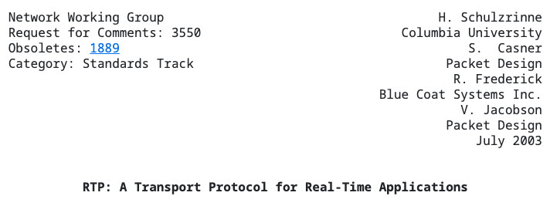
Detour: IETF
Internet Engineering Task Force
A standards organization established 1986
The main product is RFCs (“request for comments”) – these are stable standards
Work is carried out by Working Groups such as TLS, RATS
Notes:
RATS: Remote Attestation Procedures

Slide 5
Extending TLS
Attestation with or without authentication
Attestation metadata is carried instead of (or together with) an X.509 certificate
Technically, as a new certificate type
Attestation metadata is opaque to the TLS implementation
New TLS extensions to negotiate the credential type, and convey freshness
Attesting the Client, the Server or both

Slide 6


Key & Platform attestation
Combined Attestation Bundle
Platform Attestation Token
Key Attestation Token
Long Lived
Ephemeral
Attester
Workload
Workload identity key
OS kernel
Key attestation service stack
Firmware
Key Attesting Key
Bootloader
Hardware (RoT)
draft-bft-rats-kat-04
Notes:
PAT changes very rarely, KAT is per-connection

Slide 7
Message Flow (1/3)
Attestation
Service
Client
Server
Verifier
In this example, we are attesting the client
ClientHello
{…}
evidence_proposal(types(a,b,c))
POST /newSession
201 Created
Location: /76389
Body: {
nonce,
Types(a,b,c,d,e)
}
ServerHello
{…}
EncryptedExtensions
{…}
evidence_proposal ( nonce, type(a))
Notes:
As typical with new features in TLS, the client indicates support for the new extension in the ClientHello message.
The newly introduced extensions allow evidence and nonces to be exchanged.
The nonces are used for guaranteeing freshness of the exchanged evidence.
Specifically:
The TLS server needs to provide a nonce in the EncryptedExtensions message to the TLS client so that the attestation service can feed the nonce into the generation of the Evidence.

Slide 8
Message Flow (2/3)
Attestation
Service
Client
Server
Verifier
CertificateRequest
Certificate
CertificateVerify
Finished
attest_key
(nonce, TIK)
CAB (KAT,PAT)
sign (TIK, hs)
sig
Certificate(CMW{mt, CAB})
CertificateVerify(sig)
Finished
Notes:
1) When the evidence extension is successfully negotiated, the content of the Certificate message from Client
contains a payload that is encoded based on the wrapper defined in [I-D.ftbs-rats-msg-wrap].
2) In TLS a client has to demonstrate possession of the private key via the CertificateVerify message, when client-based authentication is requested.
3) The attestation payload must contain a key attestation token, which associates a private key with the attestation information. An example of a key attestation token format utilizing the EAT format can be found in [I-D.bft-rats-kat].
4) The recipient (Server) extracts Evidence from the Certificate message and relays it to the verifier to obtain attestation results.
5) Subsequently, the attested key is used to verify the CertificateVerify message.

Slide 9
Message Flow (3/3)
Attestation
Service
Client
Server
Verifier
POST /76389
Body :{
CMW(mt, CAB)
}
Body :{
att-result: AR{} }
verify AR{}
verify sig
application data

Slide 10
Mapping to the RATS Architecture
CoRIM
Reference Value Provider
Supply Chain
Verifier
CMW (Evidence)
EAR
Relying Party
TLS Server
⬅ CMW (Evidence)
Attester
TLS Client
TLS Handshake
(Certificate Message)
RATS Architecture: RFC 9334
Notes:
The Attester is the Client in the previous example, and the RP is the Server

Slide 11
Current Activities and Collaborations
Specifications
Community Members
Formal
Verification
Implementation
Prototype
TU Dresden
Community Members

Slide 12
Status of Implementation
An end-to-end working proof of concept is available
From Attester through a TLS implementation, to a Verifier
Uses Background Check model, with TPM 2.0 as a RoT
Open-Source availability of entire stack
The components themselves are open-source software
Project harbored under CCC-Attestation SIG
Work In Progress on a Confidential Computing (CC) version of Attester running in a confidential environment: ARM-CCA

Slide 13
Open-Source Implementations
Multiple (different) implementations of TLS with attestation:
Open Enclave Attested TLS (Microsoft)
Split-Trust Encryption Tool (Google)
Gramine RA-TLS
Attested TLS PoC (Attested TLS Internet Draft)
Commercial Projects
Attestation within TLS handshake in Constellation (by Edgeless Systems)

Slide 14
Thank You!
Yaron Sheffer, yaronf@intuit.com

Slide 15
Backup

Slide 16











Prototype Architecture
Verification
Server
Verifier
TLS Stack (MbedTLS)
Server Certificate
Handshake (Augmented)
Secure Channel
Attestation Evidence
Client
TLS Stack (MbedTLS)
Client Private + Attestation Key(s)
Platform State
Client RoT

Slide 17
Usage of RATS Drafts
Draft Name | Describes
Attestation in TLS and DTLS | Describes TLS extensions to use attestation for authentication
EAT based Key attestation Token | Evidence format of combined key and platform attestation
CoRIM | Concise Reference Integrity Manifest (CoRIM), a standardised way to convey Reference Values and Endorsed Values to a Verifier
EAT Attestation Results (EAR) | An EAT profile for conveyance of Attestation Results
CMW | A format used to Wrap RATS Messages in a protocol agnostic way
EAT Collection Types | An extension to EAT allowing the top-level token to consist of a collection of otherwise defined tokens

Slide 18
Main Open-Source Repositories
Repository Name(link) | Contains
CCC Attested TLS PoC | Central space for open collaboration on the proof of concept
Parsec | Library to abstract Attester Evidence Formats
Mbed TLS library | TLS Library
Veraison | Attestation Verification deployment
ctoken | A C library to implement EAT, CWT and UCCS
t_cose | A C Library to implement COSE RFC 9052
Notes:
Highlight that this is not a complete set

Slide 19
Introduction
Historically Transport Layer Security (TLS) protocol has relied on Public Key Infrastructure (PKI) for authentication
Remote Attestation presents an enhancement to PKI, leveraging hardware features to provide comprehensive information about the security state of the device
Our work is focused on standardising remote attestation as a native authentication mechanism in TLS
Also backed by an Open-Source proof of concept project, supported by the Confidential Consortium Attestation Special Interest Group

